Slide 1

Michael & Sara Franks

Slide 2
The following presentation is of a general nature. It’s purpose is to illustrate the logical steps that need to be considered when making decisions about investments.
Michael & Sara Franks

Slide 3

Promoting your JV Deal
Michael & Sara Franks

Slide 4


Promoting your JV Deal
WHEN?
Before finding a deal?
After finding a deal
Michael & Sara Franks

Slide 5
Promoting your JV Deal
Presentation ideally is a summary kept to the minimum.
Can be a written narrative – take care to be brief and concise.
Can be a bullet pointed list with headings.
Aim to contain in a single page.
Put important points to the top and grade in importance.
Michael & Sara Franks

Slide 6
Promoting your JV Deal
DEAL SUMMARY- (Before finding a deal)
PROJECT
Type of Property
Applied Strategies
Duration
Approx Location
PARTNER REQUIREMENTS/OFFERINGS
Proposing Partner Contributions - Property, Equity, Loans, Time, Security
Required Partner/s Contributions - Property, Equity, Loans, Time, Security
ABOUT THE PROPOSING PARTNER
Experience
Skills
Training
Contact Details
Michael & Sara Franks

Slide 7
Promoting your JV Deal
DEAL SUMMARY- (After finding a deal)
FINANCIAL OFFERINGS and REQUIREMENTS
Profits/Returns
Proposing Partner Contributions - Property, Equity, Loans, Time, Security
Required Partner Contributions - Property, Equity, Loans, Time, Security
PROJECT
Type of Property
Applied Strategies
Duration
Approx Location
ABOUT THE PROPOSING PARTNER
Experience
Skills
Training
Contact Details
Third Party Ref, JV Agreement, Feasibility Study, IM – Supplied on Request
Michael & Sara Franks

Slide 8
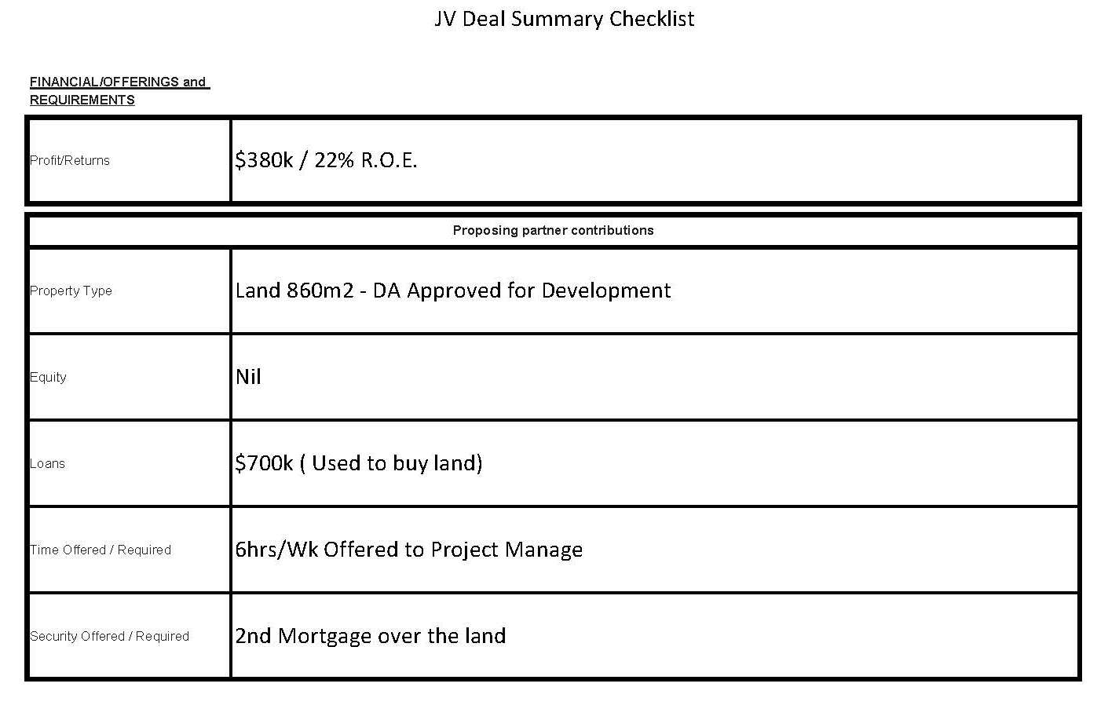
Promoting your JV Deal
DEAL SUMMARY- (After finding a deal)
FORM AVAILABLE UNDER DOWNLOADS
Michael & Sara Franks

Slide 9
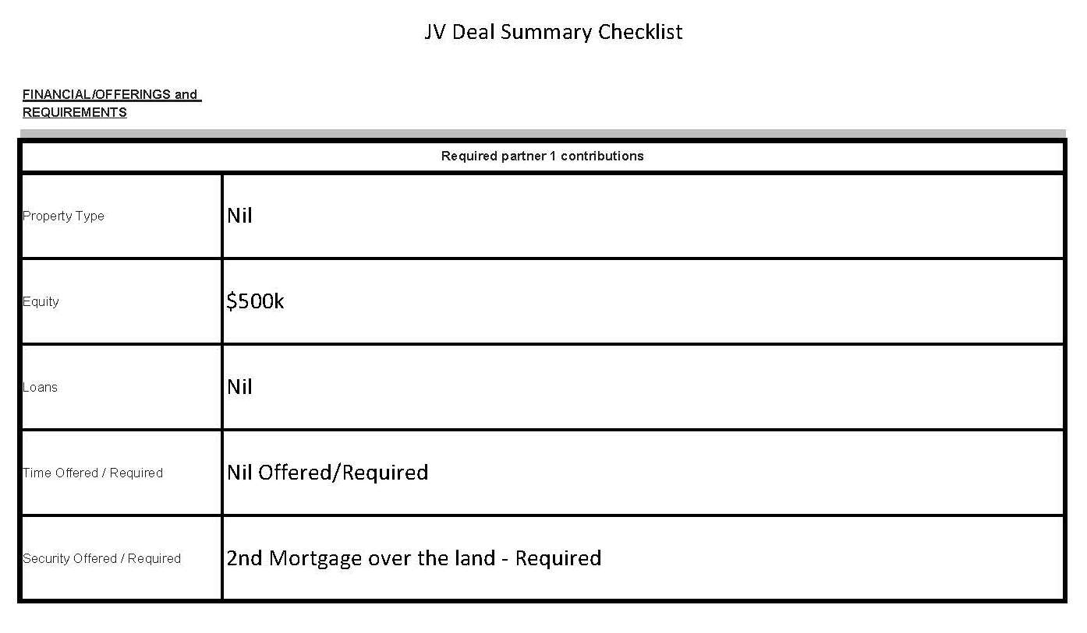
Promoting your JV Deal
DEAL SUMMARY- (After finding a deal)
FORM AVAILABLE UNDER DOWNLOADS
Michael & Sara Franks

Slide 10
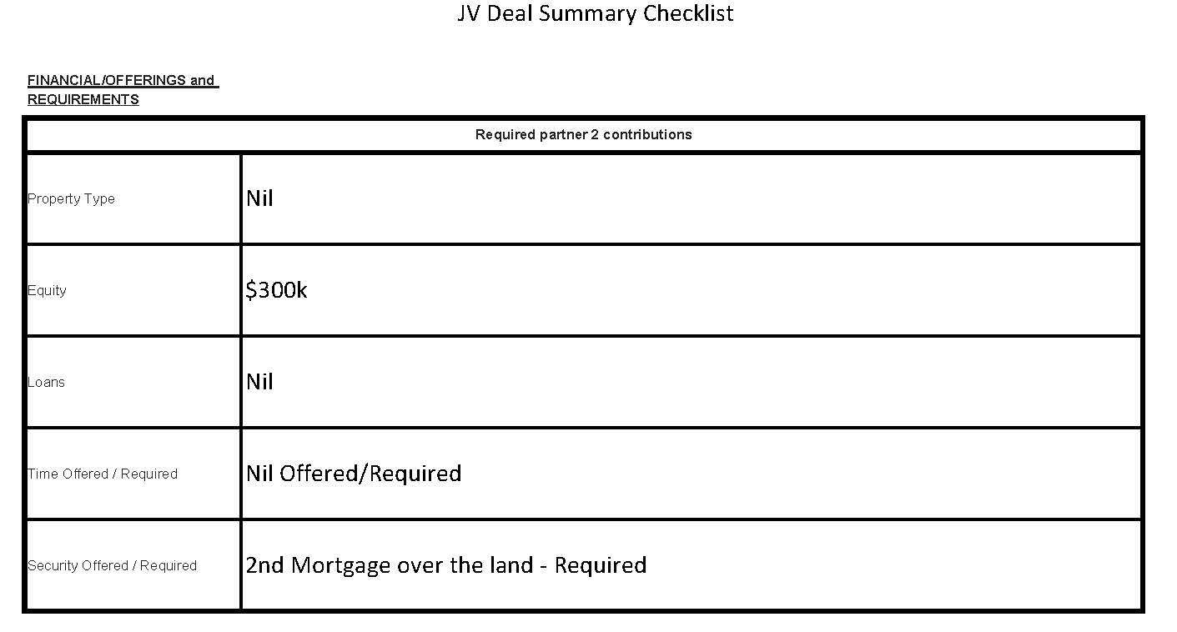
Promoting your JV Deal
DEAL SUMMARY- (After finding a deal)
FORM AVAILABLE UNDER DOWNLOADS
Michael & Sara Franks

Slide 11
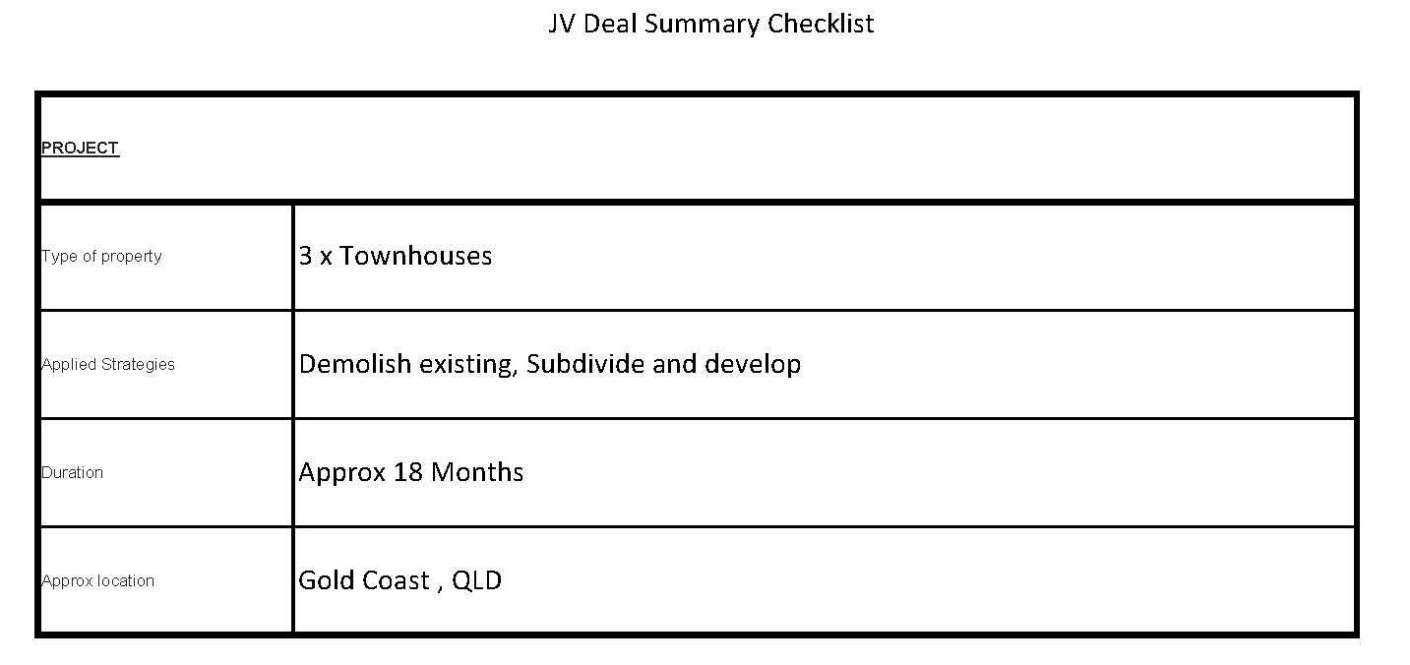
Promoting your JV Deal
DEAL SUMMARY- (After finding a deal)
FORM AVAILABLE UNDER DOWNLOADS
Michael & Sara Franks

Slide 12
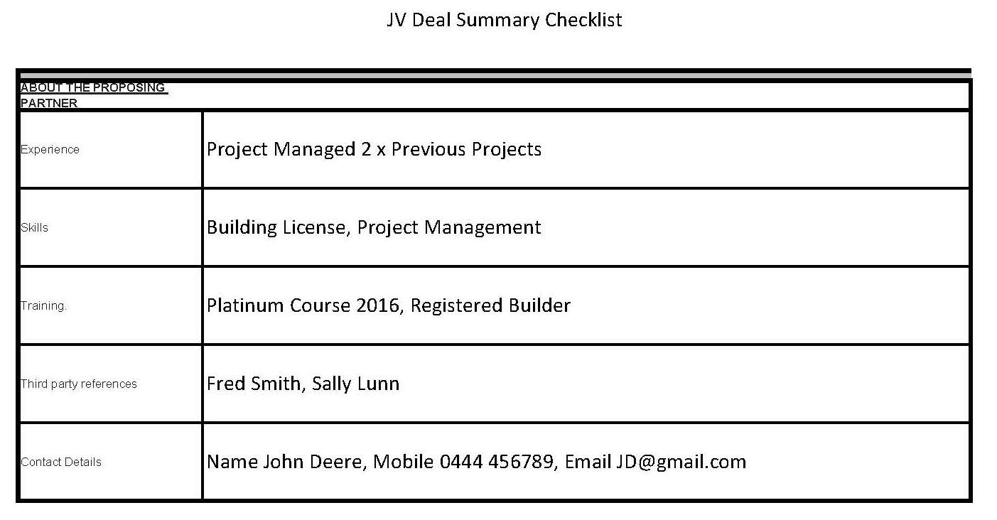
Promoting your JV Deal
DEAL SUMMARY- (After finding a deal)
FORM AVAILABLE UNDER DOWNLOADS
Michael & Sara Franks

Slide 13
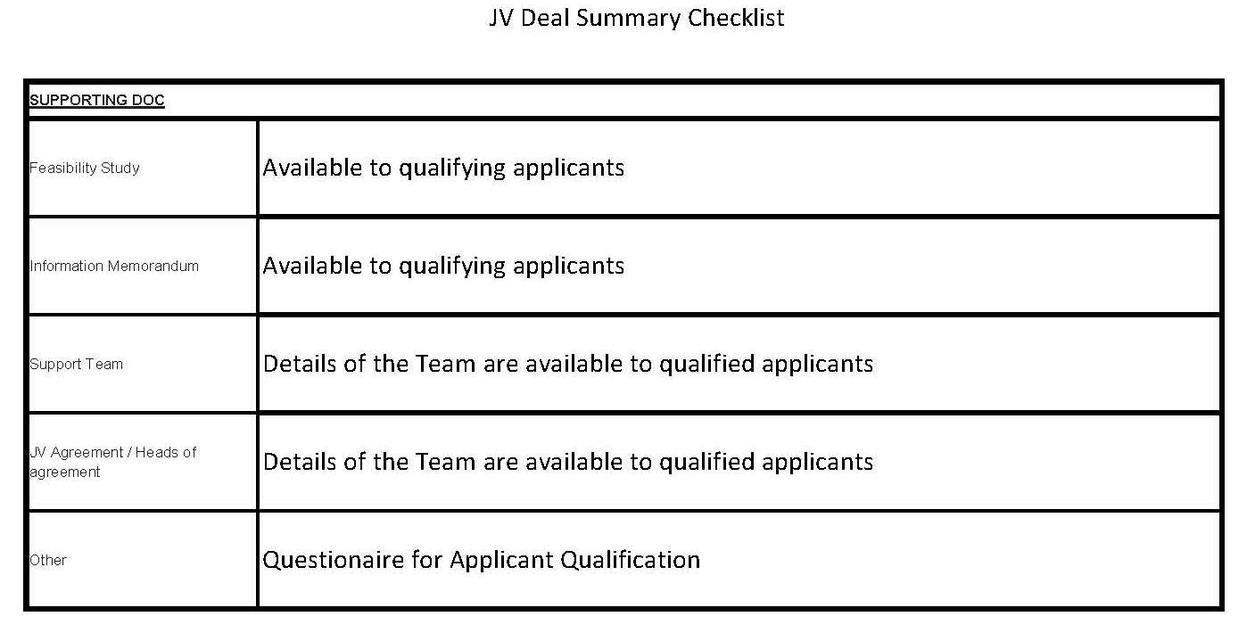
Promoting your JV Deal
DEAL SUMMARY- (After finding a deal)
FORM AVAILABLE UNDER DOWNLOADS
Michael & Sara Franks

Slide 14
Promoting your JV Deal
Where to Promote
JV Partner Wanted section – Forum on member website
Local investing groups.
Family members
Letter Drop - Cold Calling
Real Estate Agents
Workmates
Ultimate Members through personal networking ( Not Facebook)
Michael & Sara Franks

Slide 15
Promoting your JV Deal
Follow Up
Qualifying The Partner
Recap of Promotion.
Supply of Documentation.
Michael & Sara Franks

Slide 16
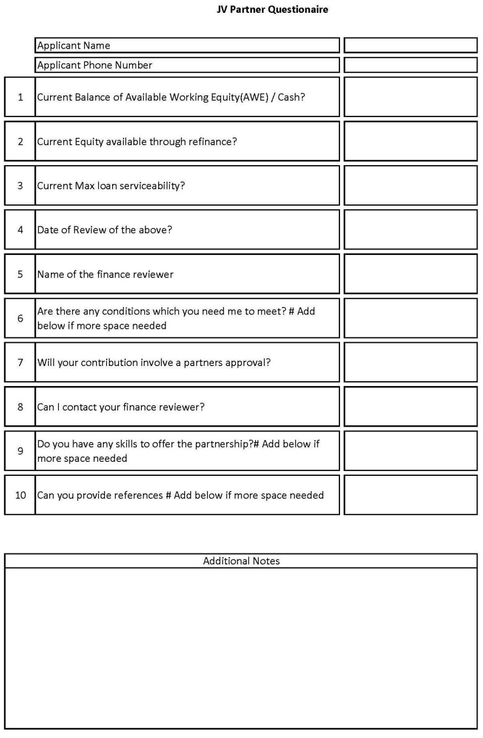
Promoting your JV Deal
FORM AVAILABLE UNDER DOWNLOADS
Qualifying the Partner
Current Balance of AWE/Cash?
Current Equity Available through refinance?
Current Max Loan Serviceability?
Date of the review of the above?
Name of finance reviewer?
Are there any conditions which you need me to meet?
Will your contribution involve a partners approval?
Can I contact your finance reviewer?
Do you have any skills to offer the partnership?
Can you provide references?
Michael & Sara Franks

Slide 17
Michael & Sara Franks

