Slide 1



February
Mastermind
Event
Renovation

Slide 2
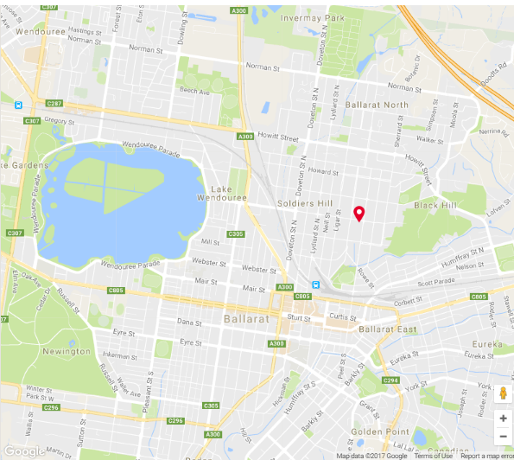


Prioritize Suburbs to Research
Consider Proximity to – CBD, transport, jobs, lifestyle, neighboring expensive suburbs etc. – create table
Use Google
maps etc.

Slide 3
Activity – Prioritize suburb list
Use Heat map / street map & summarise in table
Note suburb characteristics & prioritize suburbs e.g. 1- 6 to ID target suburbs
Suburb | Median $ | Characteristics | Priority
Black Hill | $315k | Close to CBD, boarders expensive suburb, train station, good road access, price growth …………………,
Ballarat North | $285k
Ballarat East | $295k
Golden Point | $295k
Delacombe | $290k
Alfredton | $320k

Slide 4
Activity - Calculate % Variance (Manual Method)
Calculate % variance in table
Suburb | Low | Mid | High | Variance % (low to mid)
Black Hill | $220k | $350k | $830k | 59.1%
Delacombe | $295k | $355k | $431k
Ballarat East | $241k | $317k | $437k
Golden Point | $228k | $267k | $302k
Ballarat North | $246k | $358k | $519k
Alfredton | $333k | $437k | $575k

Slide 5
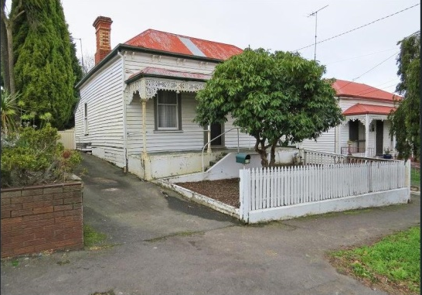
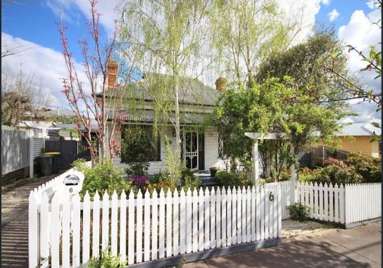
Activity – Calculate Rule of Thumb
Black Hill - Purchase @ low = $220k
 | Rule of Thumb% | Low = $220k
Cosmetic Reno | 10%
Purchase Costs | 6%
Hold Costs | 2%
Sales Costs | 3%
Profit Margin | 15%
Total | 36%
Sale Price Target | 136%

Slide 6
Activity – List Research to Confirm Demand
  ________________________________________
  ________________________________________
  ________________________________________
  ________________________________________
  ________________________________________
  ________________________________________
  ________________________________________
  ________________________________________

Slide 7
Activity – Research Demand – Black Hill
  ________________________________________
  ________________________________________
  ________________________________________
  ________________________________________
  ________________________________________
  ________________________________________
  ________________________________________
  ________________________________________

Slide 8
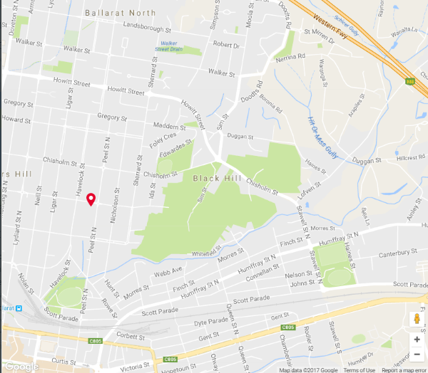
Become an Area Expert – Street map --- Black Hill

Slide 9
Activity – List Characteristics to Show on Map
  Use Street/Aerial Map – Google Earth
  ________________________________________
  ________________________________________
  ________________________________________
  ________________________________________
  ________________________________________
  ________________________________________
  ________________________________________

Slide 10
Activity – List Deal Finding Strategies
  ________________________________________
  ________________________________________
  ________________________________________
  ________________________________________
  ________________________________________
  ________________________________________
  ________________________________________
  ________________________________________

Slide 11
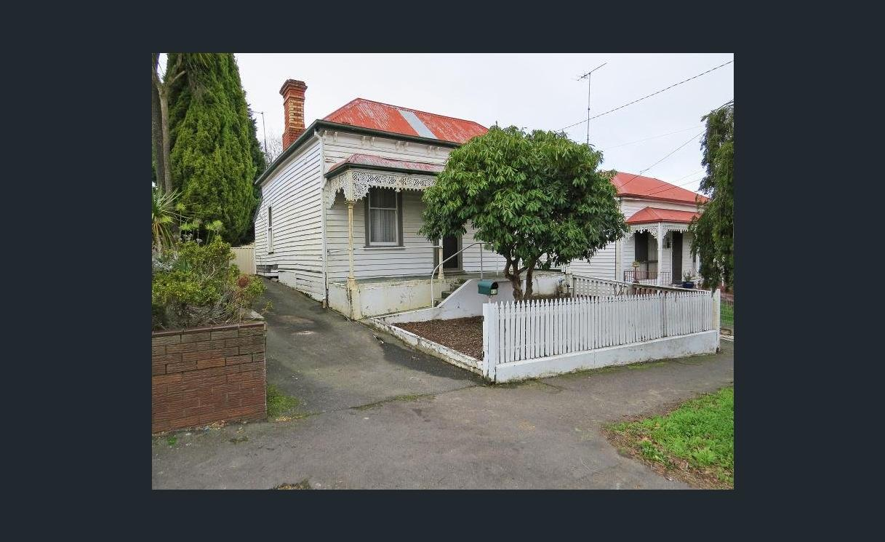
Frontage & Yard
  ______________________________
  ______________________________
  ______________________________
  ______________________________
  ______________________________
  ______________________________
  ______________________________
  ______________________________

Slide 12
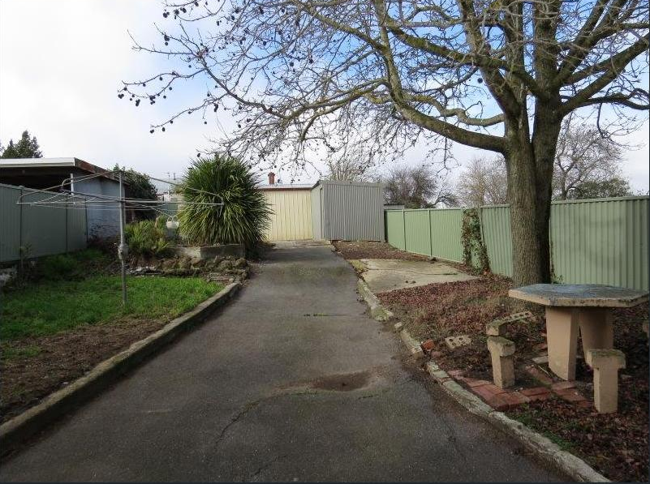
Driveway & Yard
  ______________________________
  ______________________________
  ______________________________
  ______________________________
  ______________________________
  ______________________________
  ______________________________
  ______________________________

Slide 13
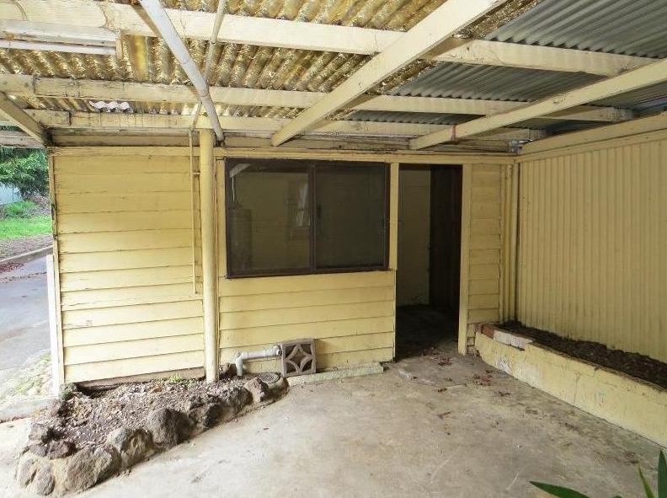
Rear & Yard
  ______________________________
  ______________________________
  ______________________________
  ______________________________
  ______________________________
  ______________________________
  ______________________________
  ______________________________

Slide 14
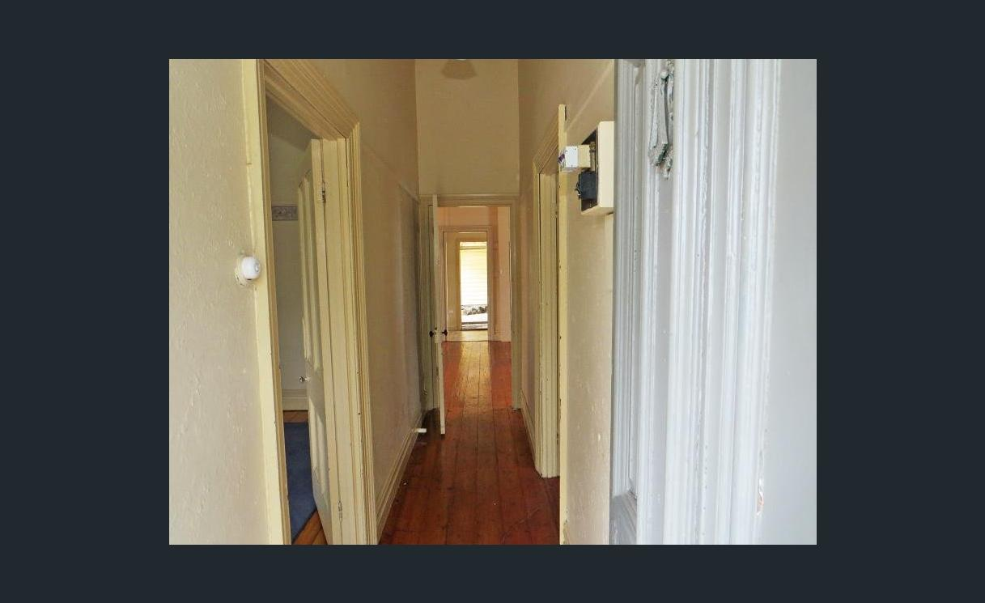
Entry / Hallway
  ______________________________
  ______________________________
  ______________________________
  ______________________________
  ______________________________
  ______________________________
  ______________________________
  ______________________________

Slide 15
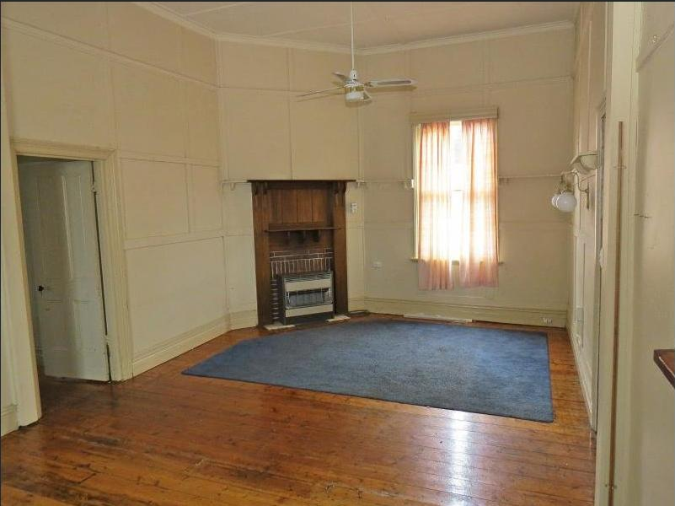
Lounge
  ______________________________
  ______________________________
  ______________________________
  ______________________________
  ______________________________
  ______________________________
  ______________________________
  ______________________________

Slide 16
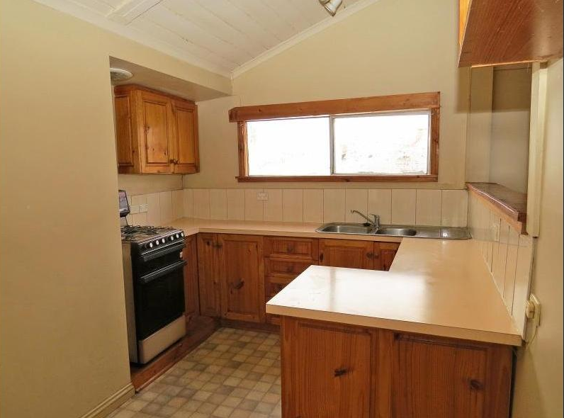
Kitchen
  ______________________________
  ______________________________
  ______________________________
  ______________________________
  ______________________________
  ______________________________
  ______________________________
  ______________________________

Slide 17
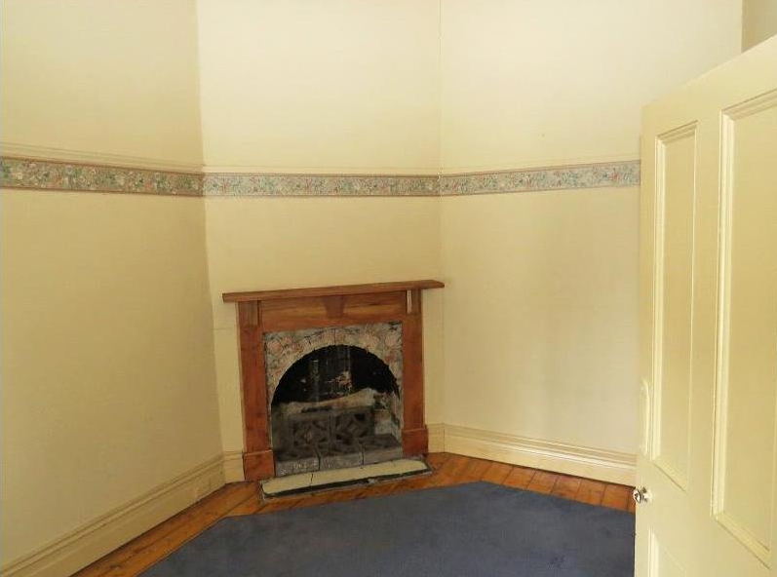
Bedrooms
  ______________________________
  ______________________________
  ______________________________
  ______________________________
  ______________________________
  ______________________________
  ______________________________
  ______________________________

Slide 18
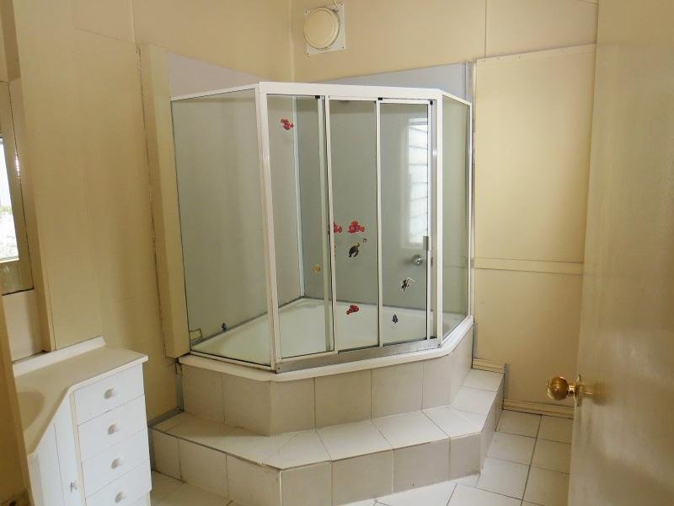
Bathroom
  ______________________________
  ______________________________
  ______________________________
  ______________________________
  ______________________________
  ______________________________
  ______________________________
  ______________________________

Slide 19
Activity – List Property Due Diligence
  ________________________________________
  ________________________________________
  ________________________________________
  ________________________________________
  ________________________________________
  ________________________________________
  ________________________________________
  ________________________________________

Slide 20
Activity – List Ways of Costing SOW
  ________________________________________
  ________________________________________
  ________________________________________
  ________________________________________
  ________________________________________
  ________________________________________
  ________________________________________
  ________________________________________

Slide 21
Activity – Compare SOW to Budget & Trim Costs
  Budget = 10% of Purchase ($220k) = __________
  List ways to trim costs
  ________________________________________
  ________________________________________
  ________________________________________
  ________________________________________
  ________________________________________
  ________________________________________
  ________________________________________

Slide 22
Activity - Rough Feasibility -
  Start from the end product & work backwards
  Fill in headings and costs - $220k purchase
Item | $
___________________ Value
Sale _____________
________________ Price
Purchase _____________
Strategy ____________ - Renovation
______________ Costs
Total _____________
Profit / ___________

Slide 23
Activity – List Purpose / Benefit Working SOW
  ________________________________________
  ________________________________________
  ________________________________________
  ________________________________________
  ________________________________________
  ________________________________________
  ________________________________________
  ________________________________________

Slide 24
b) Works Program
Activity – List info captured in works program
  ________________________________________
  ________________________________________
  ________________________________________
  ________________________________________
  ________________________________________
  ________________________________________
  ________________________________________

Slide 25
Phase 6 – Project Management – Doing the Doing
Activity – List what can go wrong
  ________________________________________
  ________________________________________
  ________________________________________
  ________________________________________
  ________________________________________
  ________________________________________
  ________________________________________

